Slide 1
RNA-seq data analysis:
Cristian Riccio (cr517@cam.ac.uk)
Guillermo Parada (guillermo.parada@sanger.ac.uk)

Slide 2
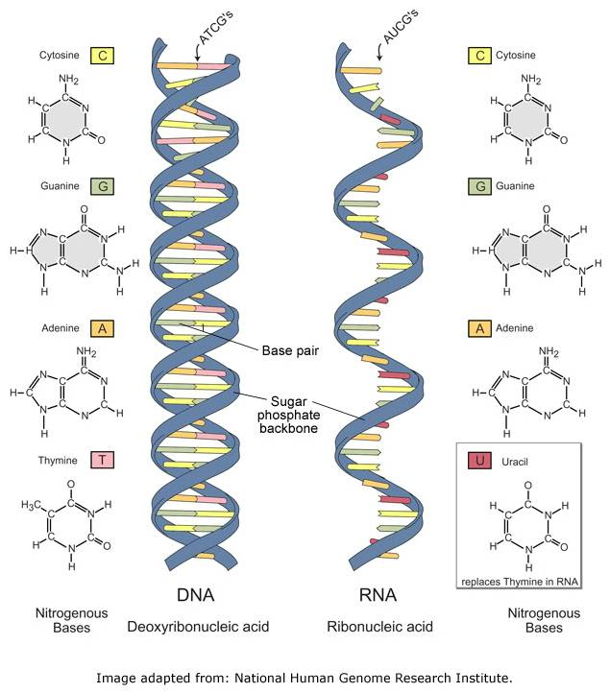
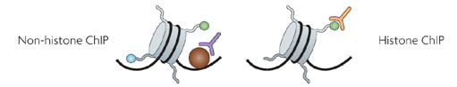
HTS Applications - Overview
DNA Sequencing
Genome Assembly
DNA methylation
ChIP-sequencing
Transcription Factor Binding Sites
RNA-sequencing
Transcriptome Assembly
Gene Expression
SNPs
Differential Expression
Chromatin Modification Regions

Slide 3
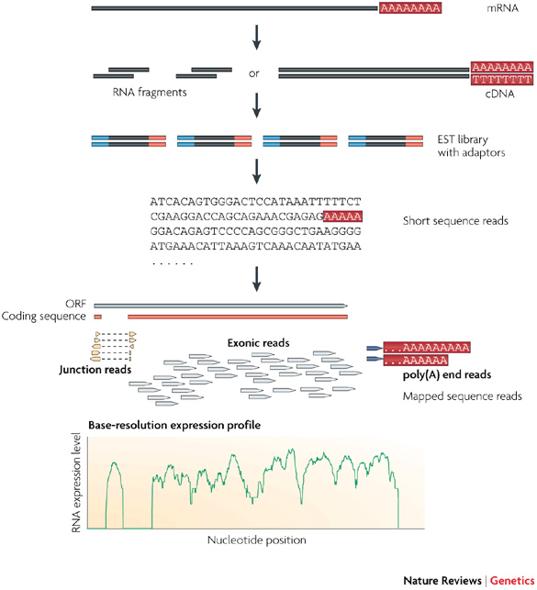
RNA-seq workflow
Library Preparation
Sequencing
Bioinformatics Analysis
Step1
Step2
Step3
Image adapted from: Wang, Z., et al. (2009), Nature Reviews Genetics, 10, 57–63.

Slide 4
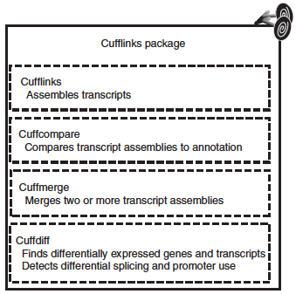
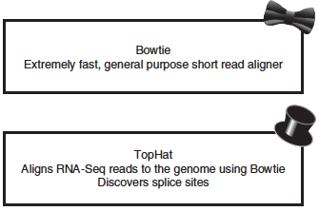
Step 3 - RNA-seq analysis workflow*
* if the reference genome is available
QC
Alignment
Transcriptome Assembly
Differential Expression
Trapnell, C., et al. (2012), Nature protocols, 7(3), 562–578.

Slide 5
Quality Control
Essential for downstream analysis.
Decide sensibly on which data can be filtered out from the downstream analysis.
You might find yourself going back to that step several times during downstream analysis.

Slide 6
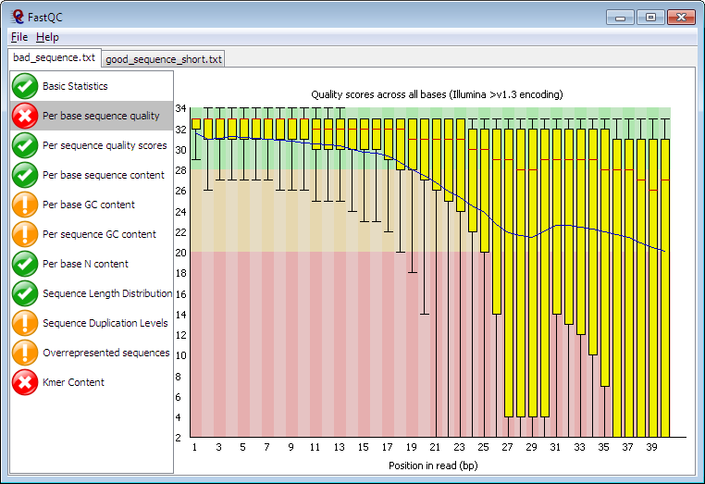
FastQC

Slide 7
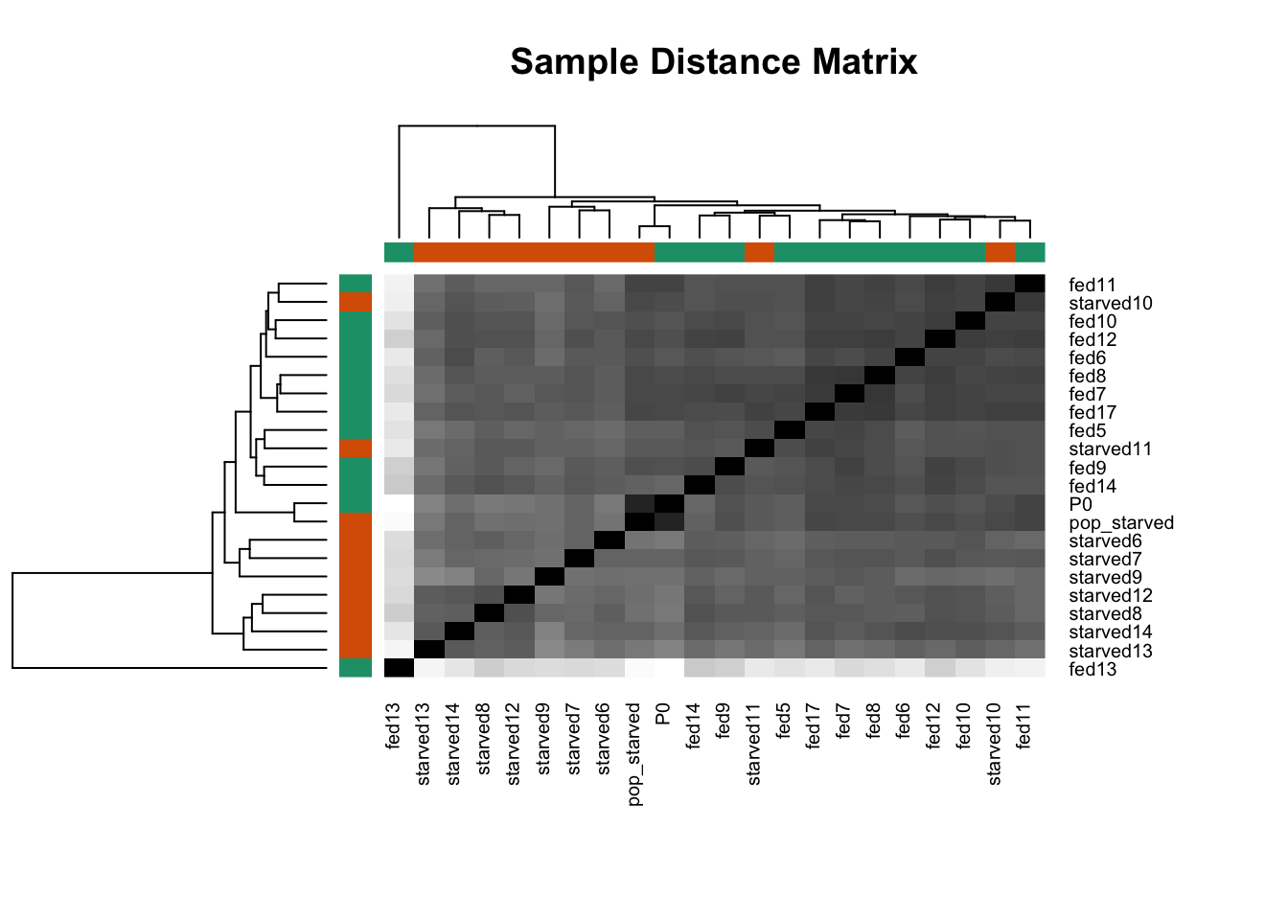
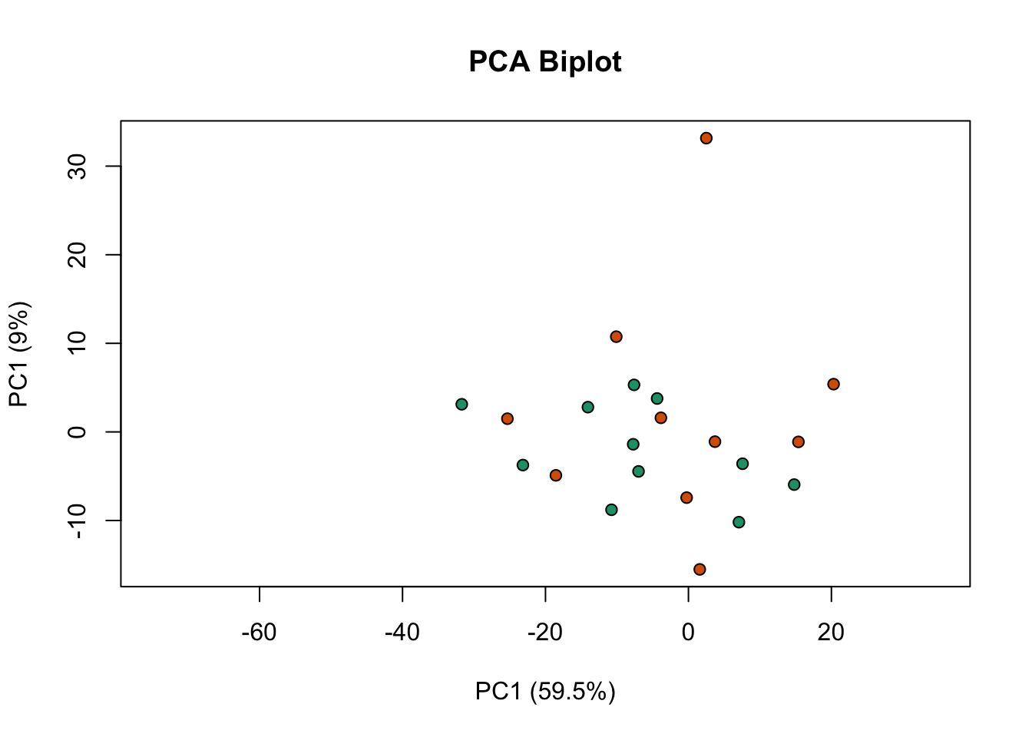
Filtering outliers

Slide 8
Alignment
AIM: Given a reference sequence and a set of short reads, align each read to the reference sequence
Reference Sequence
..GCTGATGTGCCGCCTCACTTCGGTGGT..
CTGATGTGCCGCCTCACTTCGGTGGT
TGATGTGCCGCCTCACTACGGTGGTG
Short-reads
GATGTGCCGCCTCACTTCGGTGGTGA
GCTGATGTGCCGCCTCACTACGGTG
GCTGATGTGCCGCCTCACTACGGTG

Slide 9
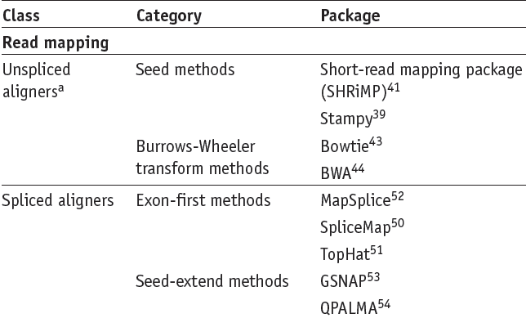
Alignment
Garber, M., et al. (2011), Nature Methods, 8(6), 469–477.

Slide 10
Aliments are reported as SAM
Most aligners used their own format to output the alignments.
Hence, downstream comparisons and analyses were difficult to perform.
To resolve this issue, Li et al. have suggested a standardized file format: the Sequence Alignment/Map (SAM) format
SAM is currently the standard format for alignment results
SAMtools is a suite of programs for interacting with high-throughput sequencing data. (http://www.htslib.org/)

Slide 11
Annotation and alignment files: SAM
SAM FORMAT
A SAM file consists of two parts:
• Header
-contains meta data (source of the reads, ref. genome, aligner, etc.)
-Header lines necessarily start with “@”.
-Header fields have standardized two-letter codes for easy parsing
• Alignment section
-A tab-separated table with at least 11 columns
-Each line describes one alignment

Slide 12
Header
Aligments

Slide 13
Normalised expression values
For gene/isoform length
Gene A
Gene B
Gene | Raw reads | Length | Normalised Reads
A | 10 | 2 | 5
B | 5 | 1 | 5
Notes:
a minimal set of paths that cover all the fragments in the overlap graph by finding the largest set of reads with the property that no two could have originated from the same isoform.
Cufflinks estimates transcript abundances using a statistical model in which the probability of observing each fragment is a linear function of the abundances of the transcripts from which it could have originated. Because only the ends of each fragment are sequenced, the length of each may be unknown. Assigning a fragment to different isoforms often implies a different length for it. Cufflinks incorporates the distribution of fragment lengths to help assign fragments to isoforms.
it uses a negative binomial model estimated from data to obtain variance estimates from which p-values are computed.

Slide 14
Normalised expression values
For total number of mapped reads
Gene A
Condition | Raw reads | Total mapped reads | Normalised Reads
x | 10 | 1000 | 0.01
z | 5 | 500 | 0.01
Condition x
Condition z
Gene A
Notes:
a minimal set of paths that cover all the fragments in the overlap graph by finding the largest set of reads with the property that no two could have originated from the same isoform.
Cufflinks estimates transcript abundances using a statistical model in which the probability of observing each fragment is a linear function of the abundances of the transcripts from which it could have originated. Because only the ends of each fragment are sequenced, the length of each may be unknown. Assigning a fragment to different isoforms often implies a different length for it. Cufflinks incorporates the distribution of fragment lengths to help assign fragments to isoforms.
it uses a negative binomial model estimated from data to obtain variance estimates from which p-values are computed.

Slide 15
FPKM (Fragment Per Kilobase Million)
I STEP: normalize by depth
GENE | REP1 | REP2 | REP3
A1 (2kb) | 10 | 12 | 30
A2 (4kb) | 20 | 25 | 60
A3 (1kb) | 5 | 8 | 15
A4 (10kb) | 0 | 0 | 1
Notes:
a minimal set of paths that cover all the fragments in the overlap graph by finding the largest set of reads with the property that no two could have originated from the same isoform.
Cufflinks estimates transcript abundances using a statistical model in which the probability of observing each fragment is a linear function of the abundances of the transcripts from which it could have originated. Because only the ends of each fragment are sequenced, the length of each may be unknown. Assigning a fragment to different isoforms often implies a different length for it. Cufflinks incorporates the distribution of fragment lengths to help assign fragments to isoforms.
it uses a negative binomial model estimated from data to obtain variance estimates from which p-values are computed.

Slide 16
FPKM (RPKM)
I STEP: normalize by depth
GENE | REP1 | REP2 | REP3
A1 (2kb) | 10 | 12 | 30
A2 (4kb) | 20 | 25 | 60
A3 (1kb) | 5 | 8 | 15
A4 (10kb) | 0 | 0 | 1
Sum all the counts
Scale by 1M (10)
35 45 106
3.5 4.5 10.6
Notes:
a minimal set of paths that cover all the fragments in the overlap graph by finding the largest set of reads with the property that no two could have originated from the same isoform.
Cufflinks estimates transcript abundances using a statistical model in which the probability of observing each fragment is a linear function of the abundances of the transcripts from which it could have originated. Because only the ends of each fragment are sequenced, the length of each may be unknown. Assigning a fragment to different isoforms often implies a different length for it. Cufflinks incorporates the distribution of fragment lengths to help assign fragments to isoforms.
it uses a negative binomial model estimated from data to obtain variance estimates from which p-values are computed.

Slide 17
FPKM (RPKM)
II STEP: divide counts by scaling factor
3.5 4.5 10.6
SCALING FACTOR
GENE | REP1 | REP2 | REP3
A1 (2kb) | 2.86 | 2.67 | 2.83
A2 (4kb) | 5.71 | 5.56 | 5.66
A3 (1kb) | 1.43 | 1.78 | 1.43
A4 (10kb) | 0 | 0 | 0.09
COUNTS -> FPM
Notes:
a minimal set of paths that cover all the fragments in the overlap graph by finding the largest set of reads with the property that no two could have originated from the same isoform.
Cufflinks estimates transcript abundances using a statistical model in which the probability of observing each fragment is a linear function of the abundances of the transcripts from which it could have originated. Because only the ends of each fragment are sequenced, the length of each may be unknown. Assigning a fragment to different isoforms often implies a different length for it. Cufflinks incorporates the distribution of fragment lengths to help assign fragments to isoforms.
it uses a negative binomial model estimated from data to obtain variance estimates from which p-values are computed.

Slide 18
FPKM (RPKM)
III STEP: divide counts by length (kb)
GENE | REP1 | REP2 | REP3
A1 (2kb) | 1.43 | 1.33 | 1.42
A2 (4kb) | 1.43 | 1.39 | 1.42
A3 (1kb) | 1.43 | 1.78 | 1.42
A4 (10kb) | 0 | 0 | 0.009
FPM -> FPKM
Notes:
a minimal set of paths that cover all the fragments in the overlap graph by finding the largest set of reads with the property that no two could have originated from the same isoform.
Cufflinks estimates transcript abundances using a statistical model in which the probability of observing each fragment is a linear function of the abundances of the transcripts from which it could have originated. Because only the ends of each fragment are sequenced, the length of each may be unknown. Assigning a fragment to different isoforms often implies a different length for it. Cufflinks incorporates the distribution of fragment lengths to help assign fragments to isoforms.
it uses a negative binomial model estimated from data to obtain variance estimates from which p-values are computed.

Slide 19
Differential Expression Analysis
Treatment vs Control
Log2( T / C)
Adjusted p-value
Notes:
, that is, whether it is greater than what would be expected just due to natural random variation.

Slide 20
Differential Expression Tools
Merino, GA., et al. (2017), bioRxiv

Slide 21
Alternative splicing

Slide 22
Alternative splicing and neuroscience

Slide 23
Cassette exons are frequent invertebrates

Slide 24
Splicing node centric model

Slide 25
Whippet: efficient and method for detection and quantification of alternative splicing

Slide 26
Coming BIG sequencing projects in the UK!

Slide 27
Coming BIG sequencing projects in the UK! Cambridge

Slide 28
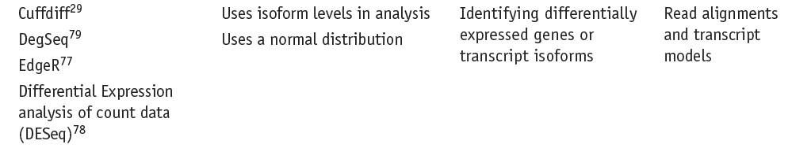
Differential Expression Tools
Garber, M., et al. (2011), Nature Methods, 8(6), 469–477.

Slide 29
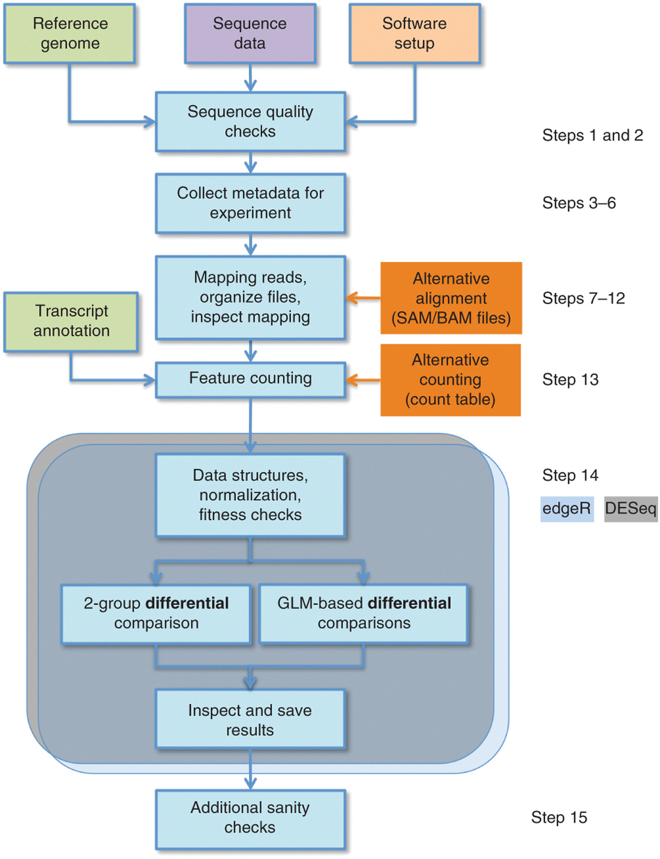
Alternative pipeline
Anders, S., et al. (2013), Nature protocols, 8, 1765–1786.

